Slide 1
Fast Binary Search Tree
- AVL and Red-Black Tree
Contents of this lecture are based on MIT OpenCourse “Introduction to Algorithms 6.046J/18.401J” given by Prof.Erik Demaine and “CSE 373 data structures” of University of Washington.

Slide 2
Goal
AVL Tree
Understanding the mechanism of AVL tree data structure
Red-Black Tree
Understanding the mechanism of Red-Black tree data structure

Slide 3
Balanced and unbalanced BST
1
4
2
2
5
3
1
3
4
4
Is this “balanced”?
5
2
6
6
1
3
5
7
7

Slide 4
Binary Search Tree - Best Time
All BST operations are O(d), where d is tree depth
minimum d is for a binary tree with N nodes
What is the best case tree?
What is the worst case tree?
So, best case running time of BST operations is O(log N)

Slide 5
Binary Search Tree - Worst Time
Worst case running time is O(N)
What happens when you Insert elements in ascending order?
Insert: 2, 4, 6, 8, 10, 12 into an empty BST
Problem: Lack of “balance”:
compare depths of left and right subtree
Unbalanced degenerate tree

Slide 6
Approaches to balancing trees
Don't balance
May end up with some nodes very deep
Strict balance
The tree must always be balanced perfectly
Pretty good balance
Only allow a little out of balance
Adjust on access
Self-adjusting

Slide 7
Balancing Binary Search Trees
Many algorithms exist for keeping binary search trees balanced
Adelson-Velskii and Landis (AVL) trees (height-balanced trees)
Splay trees and other self-adjusting trees (not covered in this lecture)
B-trees and other multiway search trees

Slide 8
Perfect Balance
Want a complete tree after every operation
tree is full except possibly in the lower right
This is expensive
For example, insert 2 in the tree on the left and then rebuild as a complete tree
6
5
Insert 2 &
complete tree
4
9
2
8
1
5
8
1
4
6
9

Slide 9
AVL - Good but not Perfect Balance
AVL trees are height-balanced binary search trees
Balance factor of a node
height(left subtree) - height(right subtree)
An AVL tree has balance factor calculated at every node
For every node, heights of left and right subtree can differ by no more than 1
Store current heights in each node

Slide 10
Height of an AVL Tree
N(h) = minimum number of nodes in an AVL tree of height h.
Basis
N(0) = 1, N(1) = 2
Induction
N(h) = N(h-1) + N(h-2) + 1
Solution (recall Fibonacci analysis)
N(h) > φ^{h} (φ ≈ 1.62)
h
h-2
h-1

Slide 11
Height of an AVL Tree
N(h) > φ^{h} (φ ≈ 1.62)
Suppose we have n nodes in an AVL tree of height h.
n > N(h) (because N(h) was the minimum)
n > φ^{h} hence log_{φ} n > h (relatively well balanced tree!!)
h < 1.44 log₂n (i.e., Find takes O(logn))

Slide 12
Node Heights
Tree A (AVL)
Tree B (AVL)
height=2 BF=1-0=1
2
6
6
1
0
1
1
4
9
4
9
0
0
0
0
0
1
5
1
5
8
height of node = h
balance factor = h_{left}-h_{right}
empty height = -1

Slide 13
Node Heights after Insert 7
Tree A (AVL)
Tree B (not AVL)
2
3
balance factor
1-(-1) = 2
6
6
1
1
1
2
4
9
4
9
0
0
0
0
0
1
-1
1
5
7
1
5
8
0
7
height of node = h
balance factor = h_{left}-h_{right}
empty height = -1

Slide 14
Insert and Rotation in AVL Trees
Insert operation may cause balance factor to become 2 or –2 for some node
only nodes on the path from insertion point to root node have possibly changed in height
So after the Insert, go back up to the root node by node, updating heights
If a new balance factor (the difference h_{left}-h_{right}) is 2 or –2, adjust tree by rotation around the node

Slide 15
Single Rotation in an AVL Tree
2
2
6
6
1
2
1
1
4
9
4
8
0
0
1
0
0
0
0
1
5
8
1
5
7
9
0
7

Slide 16
Insertions in AVL Trees
Let the node that needs rebalancing be α.
There are 4 cases:
Outside Cases (require single rotation) :
1. Insertion into left subtree of left child of α.
2. Insertion into right subtree of right child of α.
Inside Cases (require double rotation) :
3. Insertion into right subtree of left child of α.
4. Insertion into left subtree of right child of α.
The rebalancing is performed through four separate rotation algorithms.

Slide 17
AVL Insertion: Outside Case
j
Consider a valid
AVL subtree
k
h
Z
h
h
X
Y

Slide 18
AVL Insertion: Outside Case
j
Inserting into X
destroys the AVL
property at node j
k
h
Z
h+1
h
Y
X

Slide 19
AVL Insertion: Outside Case
j
Do a “right rotation”
k
h
Z
h+1
h
Y
X

Slide 20
Single right rotation
j
Do a “right rotation”
k
h
Z
h+1
h
Y
X

Slide 21
Outside Case Completed
k
“Right rotation” done!
(“Left rotation” is mirror
symmetric)
j
h+1
h
h
X
Y
Z
AVL property has been restored!

Slide 22
AVL Insertion: Inside Case
j
Consider a valid
AVL subtree
k
h
Z
h
h
X
Y

Slide 23
AVL Insertion: Inside Case
Inserting into Y
destroys the
AVL property
at node j
j
Does “right rotation”
restore balance?
k
h
Z
h
h+1
X
Y

Slide 24
AVL Insertion: Inside Case
k
“Right rotation”
does not restore
balance… now k is
out of balance
j
h
X
h
h+1
Z
Y

Slide 25
AVL Insertion: Inside Case
Consider the structure
of subtree Y…
j
k
h
Z
h
h+1
X
Y

Slide 26
AVL Insertion: Inside Case
j
Y = node i and
subtrees V and W
k
h
Z
i
h
h+1
X
h or h-1
V
W

Slide 27
AVL Insertion: Inside Case
j
We will do a left-right
“double rotation” . . .
k
Z
i
X
V
W

Slide 28
Double rotation : first rotation
j
left rotation complete
i
Z
k
W
V
X

Slide 29
Double rotation : second rotation
j
Now do a right rotation
i
Z
k
W
V
X

Slide 30
Double rotation : second rotation
right rotation complete
Balance has been
restored
i
k
j
h
h
h or h-1
V
X
W
Z

Slide 31
Example of Insertions in an AVL Tree
2
20
Insert 5, 40
0
1
10
30
0
0
25
35

Slide 32
Example of Insertions in an AVL Tree
2
3
20
20
1
1
1
2
10
30
10
30
0
0
0
1
0
0
5
25
35
5
25
35
0
40
Now Insert 45

Slide 33
Single rotation (outside case)
3
3
20
20
1
2
1
2
10
30
10
30
0
0
2
0
0
5
25
35
5
25
40
1
0
0
35
45
1
40
Imbalance
0
45
Now Insert 34

Slide 34
Double rotation (inside case)
3
3
20
20
1
3
1
2
10
30
10
35
0
0
2
0
1
5
Imbalance
25
40
5
30
40
1
0
1
0
25
34
45
35
45
0
Insertion of 34
0
34

Slide 35
Implementation
balance (1,0,-1)
key
left
right
No need to keep the height; just the difference in height, i.e. the balance factor; this has to be modified on the path of insertion even if you don’t perform rotations
Once you have performed a rotation (single or double) you won’t need to go back up the tree

Slide 36
Single Rotation
RotateFromRight(n : reference node pointer) {
p : node pointer;
p := n.right;
n.right := p.left;
p.left := n;
n := p
}
n
X
You also need to modify the heights or balance factors of n and p
Y
Z
Insert

Slide 37
Double Rotation
Implement Double Rotation in two lines.
DoubleRotateFromRight(n : reference node pointer) {
????
}
n
X
Z
V
W

Slide 38
Double Rotation Solution
DoubleRotateFromRight(n : reference node pointer) {
RotateFromLeft(n.right);
RotateFromRight(n);
}
n
X
Z
V
W

Slide 39
Insertion in AVL Trees
Insert at the leaf (as for all BST)
only nodes on the path from insertion point to root node have possibly changed in height
So after the Insert, go back up to the root node by node, updating heights
If a new balance factor (the difference h_{left}-h_{right}) is 2 or –2, adjust tree by rotation around the node

Slide 40
Insert in BST
Insert(T : reference tree pointer, x : element) : integer {
if T = null then
T := new tree; T.data := x; return 1;//the links to //children are null
case
T.data = x : return 0; //Duplicate do nothing
T.data > x : return Insert(T.left, x);
T.data < x : return Insert(T.right, x);
endcase
}

Slide 41
Insert in AVL trees
Insert(T : reference tree pointer, x : element) : {
if T = null then
{T := new tree; T.data := x; height := 0; return;}
case
T.data = x : return ; //Duplicate do nothing
T.data > x : Insert(T.left, x);
if ((height(T.left)- height(T.right)) = 2){
if (T.left.data > x ) then //outside case
T = RotatefromLeft (T);
else //inside case
T = DoubleRotatefromLeft (T);}
T.data < x : Insert(T.right, x);
code similar to the left case
Endcase
T.height := max(height(T.left),height(T.right)) +1;
return;
}

Slide 42
AVL Tree Deletion
Similar but more complex than insertion
We can delete nodes as BST, but need to rebalance
Rotations and double rotations needed to rebalance
Imbalance may propagate upward so that many rotations may be needed.

Slide 43
Pros and Cons of AVL Trees
Arguments for AVL trees:
Search is O(log N) since AVL trees are always balanced.
Insertion and deletions are also O(logn)
The height balancing adds no more than a constant factor to the speed of insertion.
Arguments against using AVL trees:
Difficult to program & debug; more space for balance factor.
Asymptotically faster but rebalancing costs time.
Most large searches are done in database systems on disk and use other structures (e.g. B-trees).
May be OK to have O(N) for a single operation if total run time for many consecutive operations is fast (e.g. Splay trees).

Slide 44
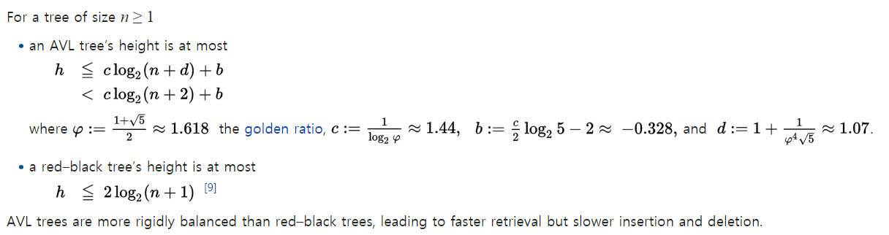
Red-Black Trees
AVL Tree
Too much overhead for maintaining the balance in insertion and deletion
Relax the constraint of balancing
-> allows more unbalanced trees

Slide 45
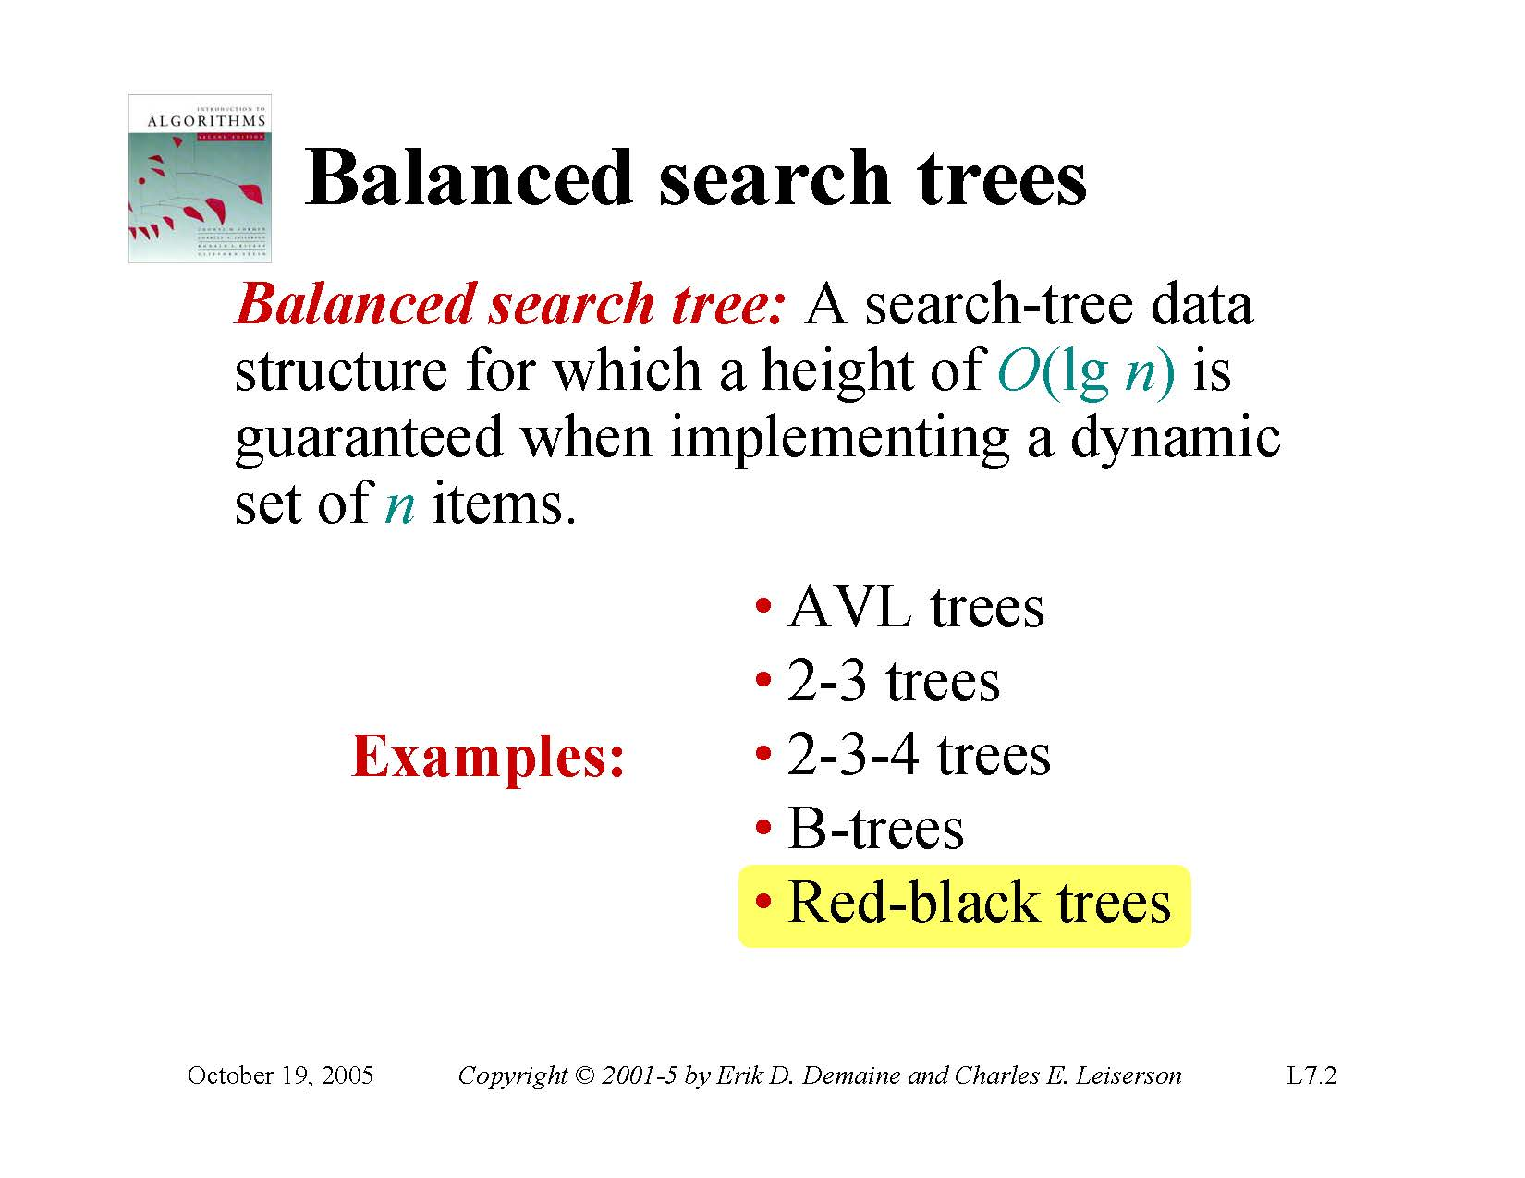

Slide 46
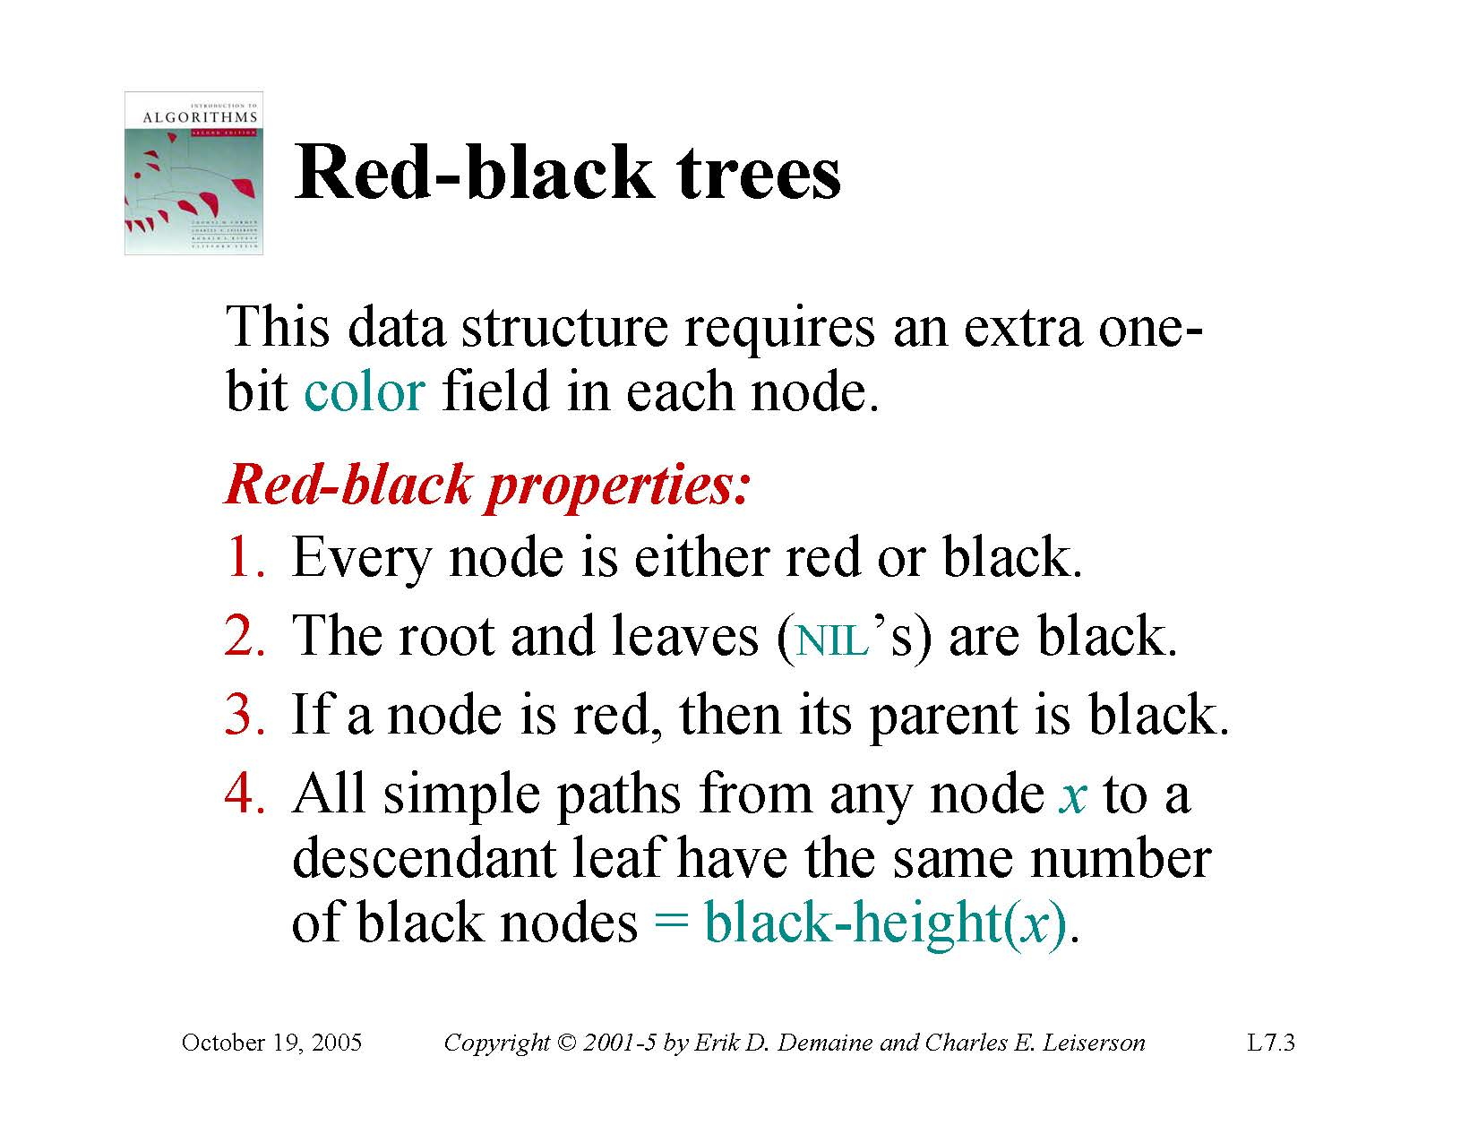

Slide 47
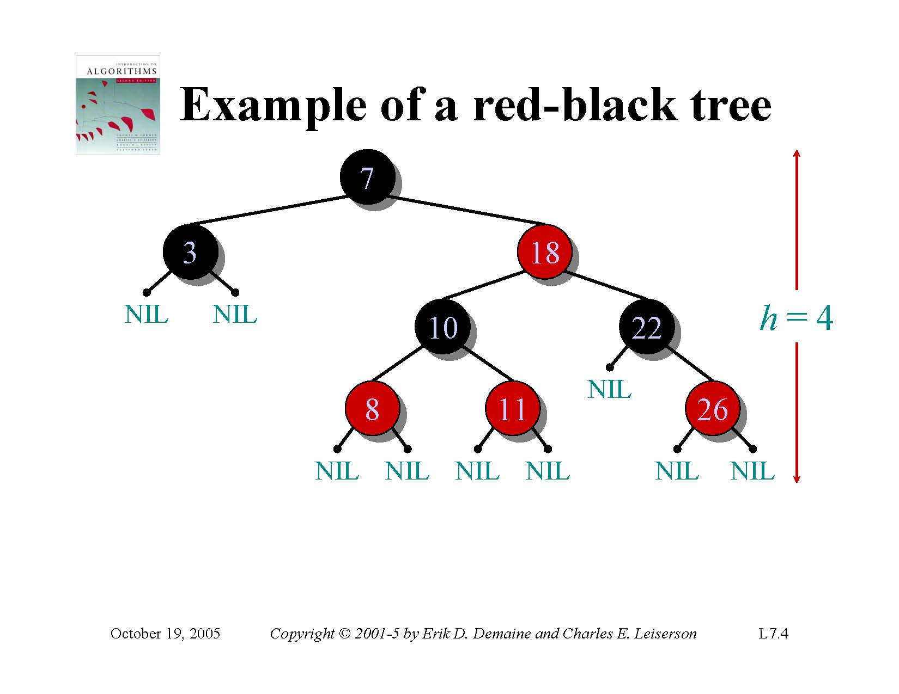

Slide 48
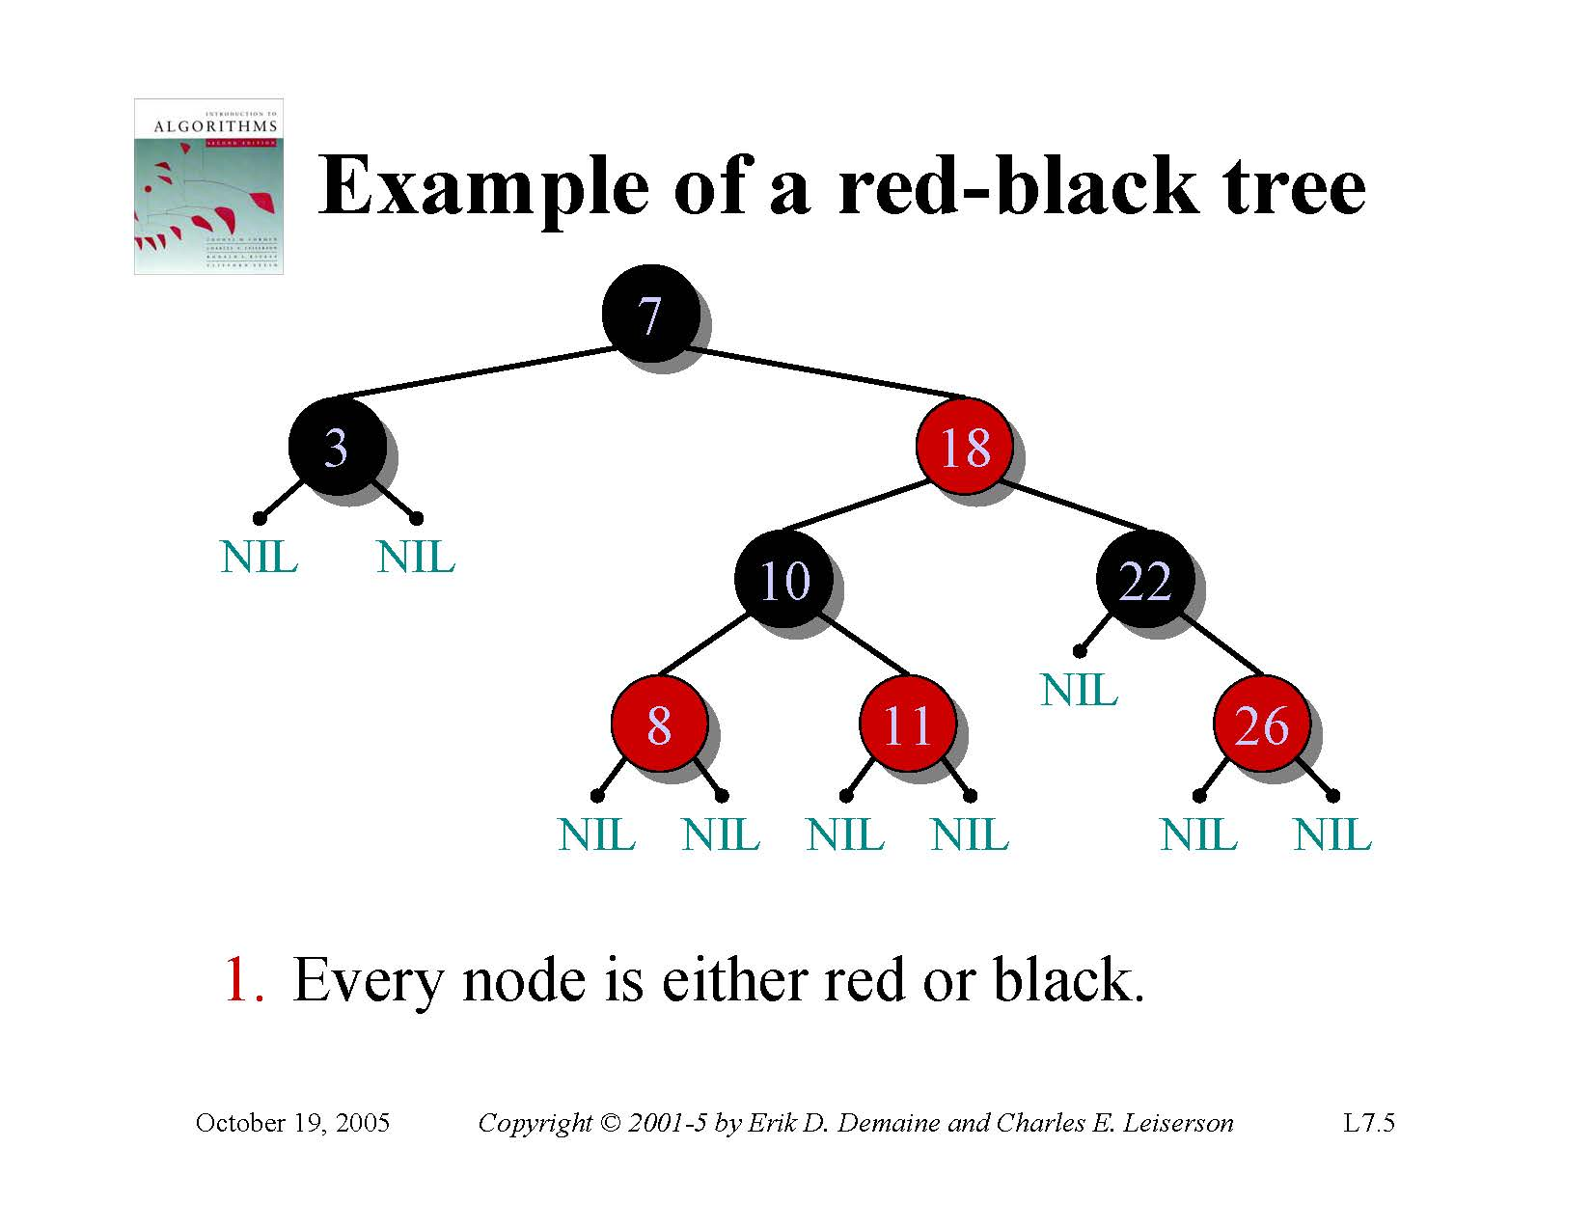

Slide 49
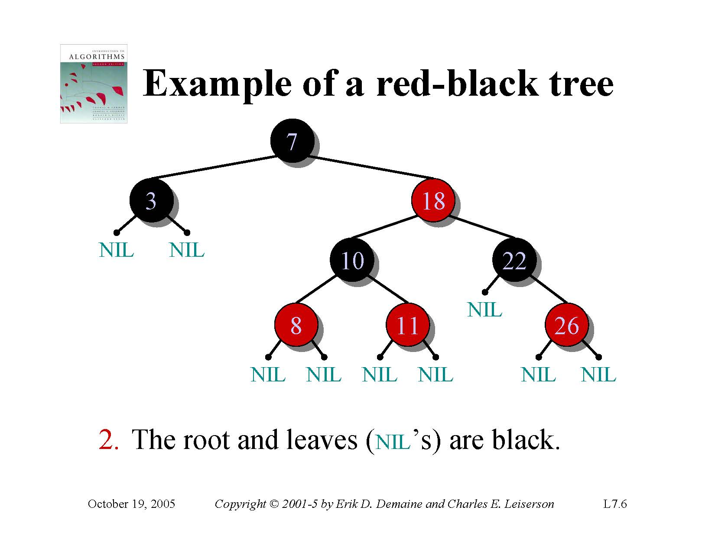

Slide 50


Slide 51
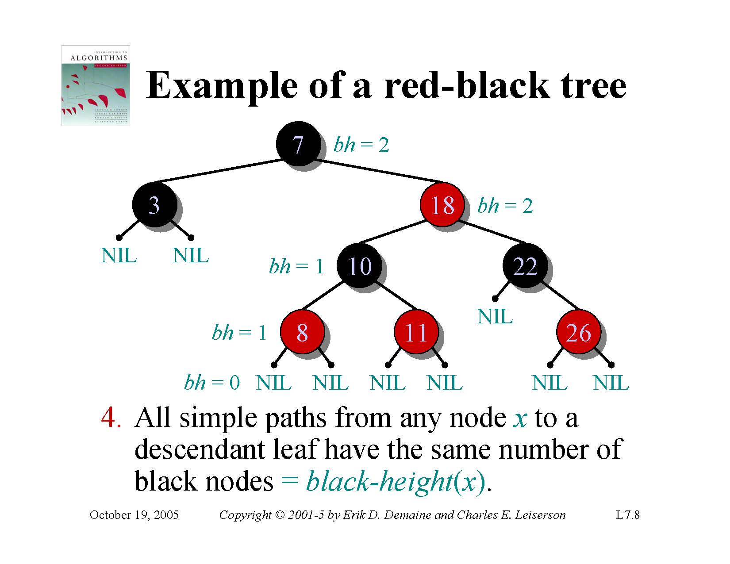

Slide 52
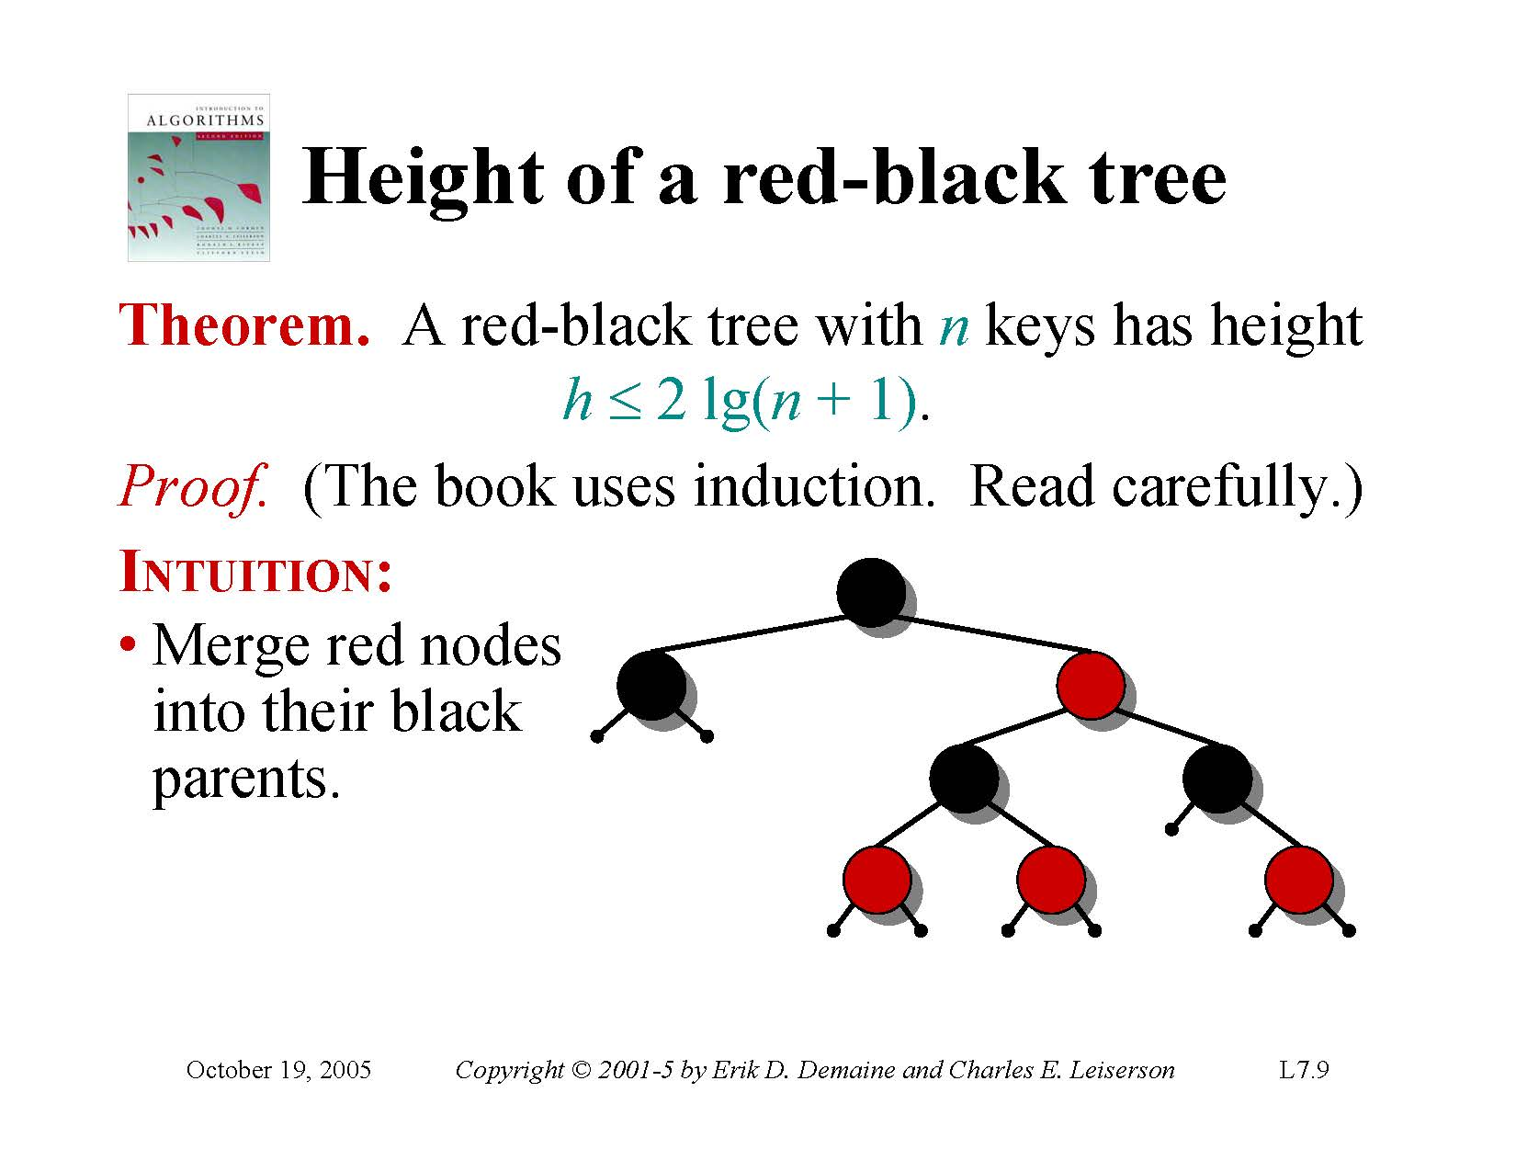

Slide 53
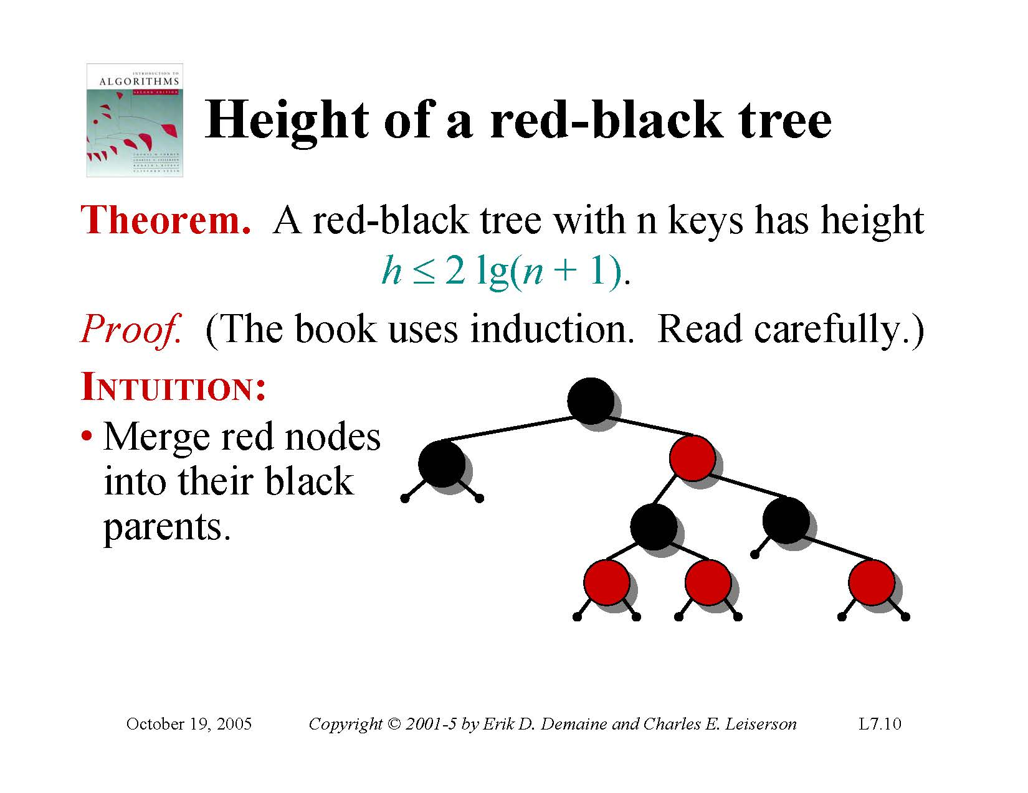

Slide 54
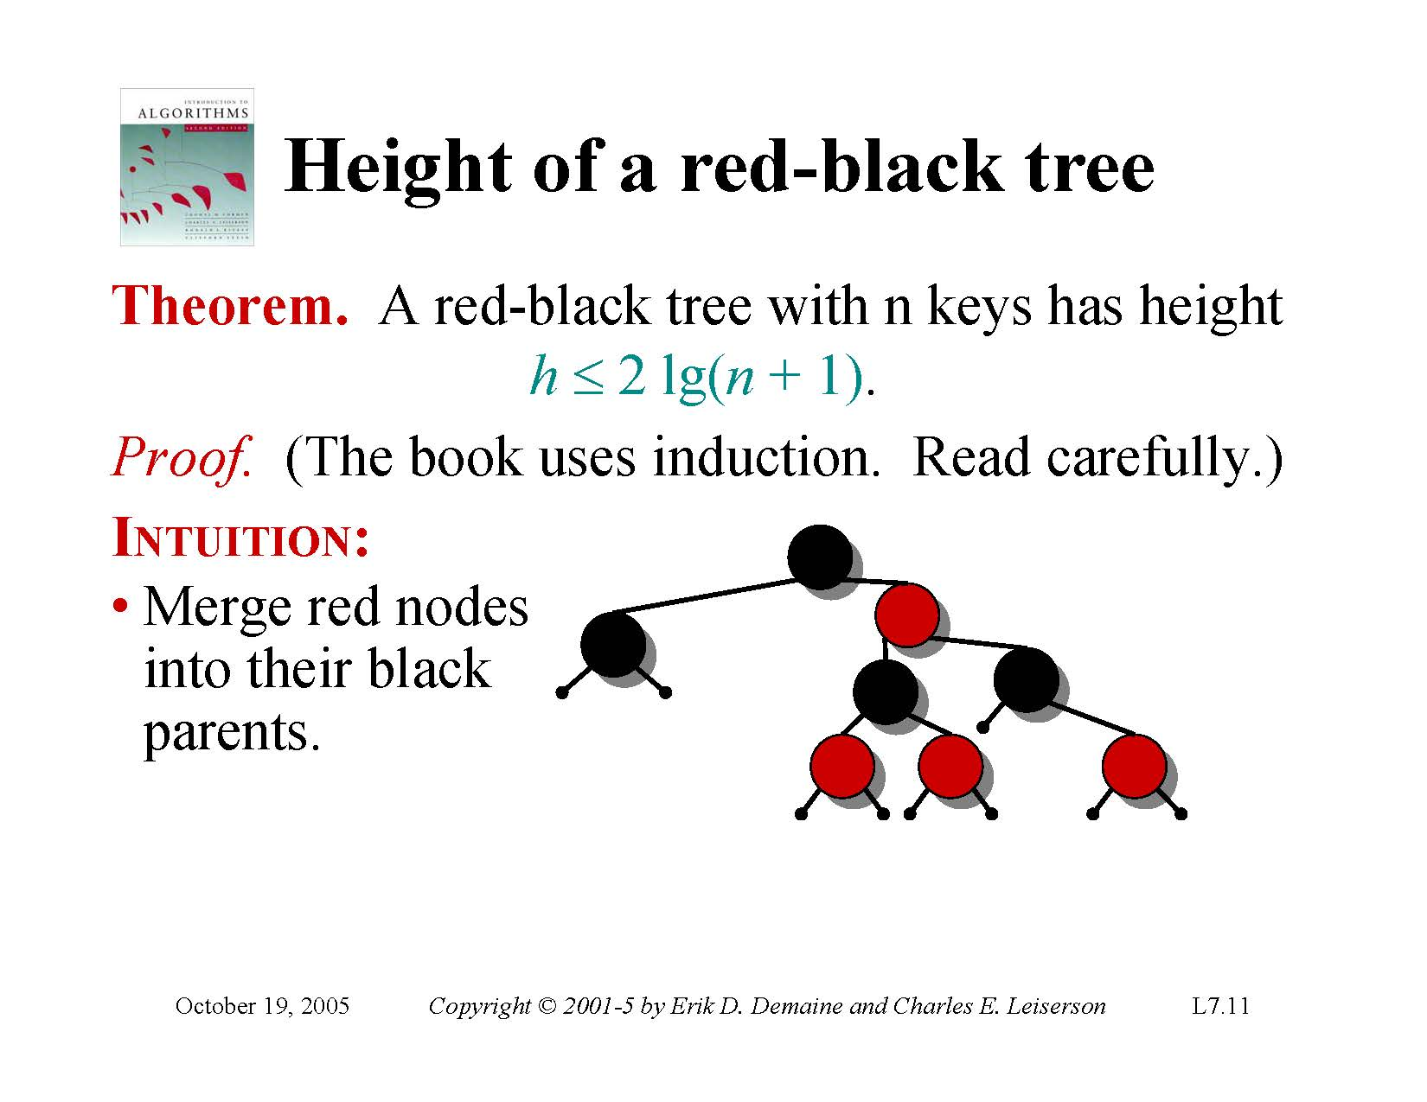

Slide 55
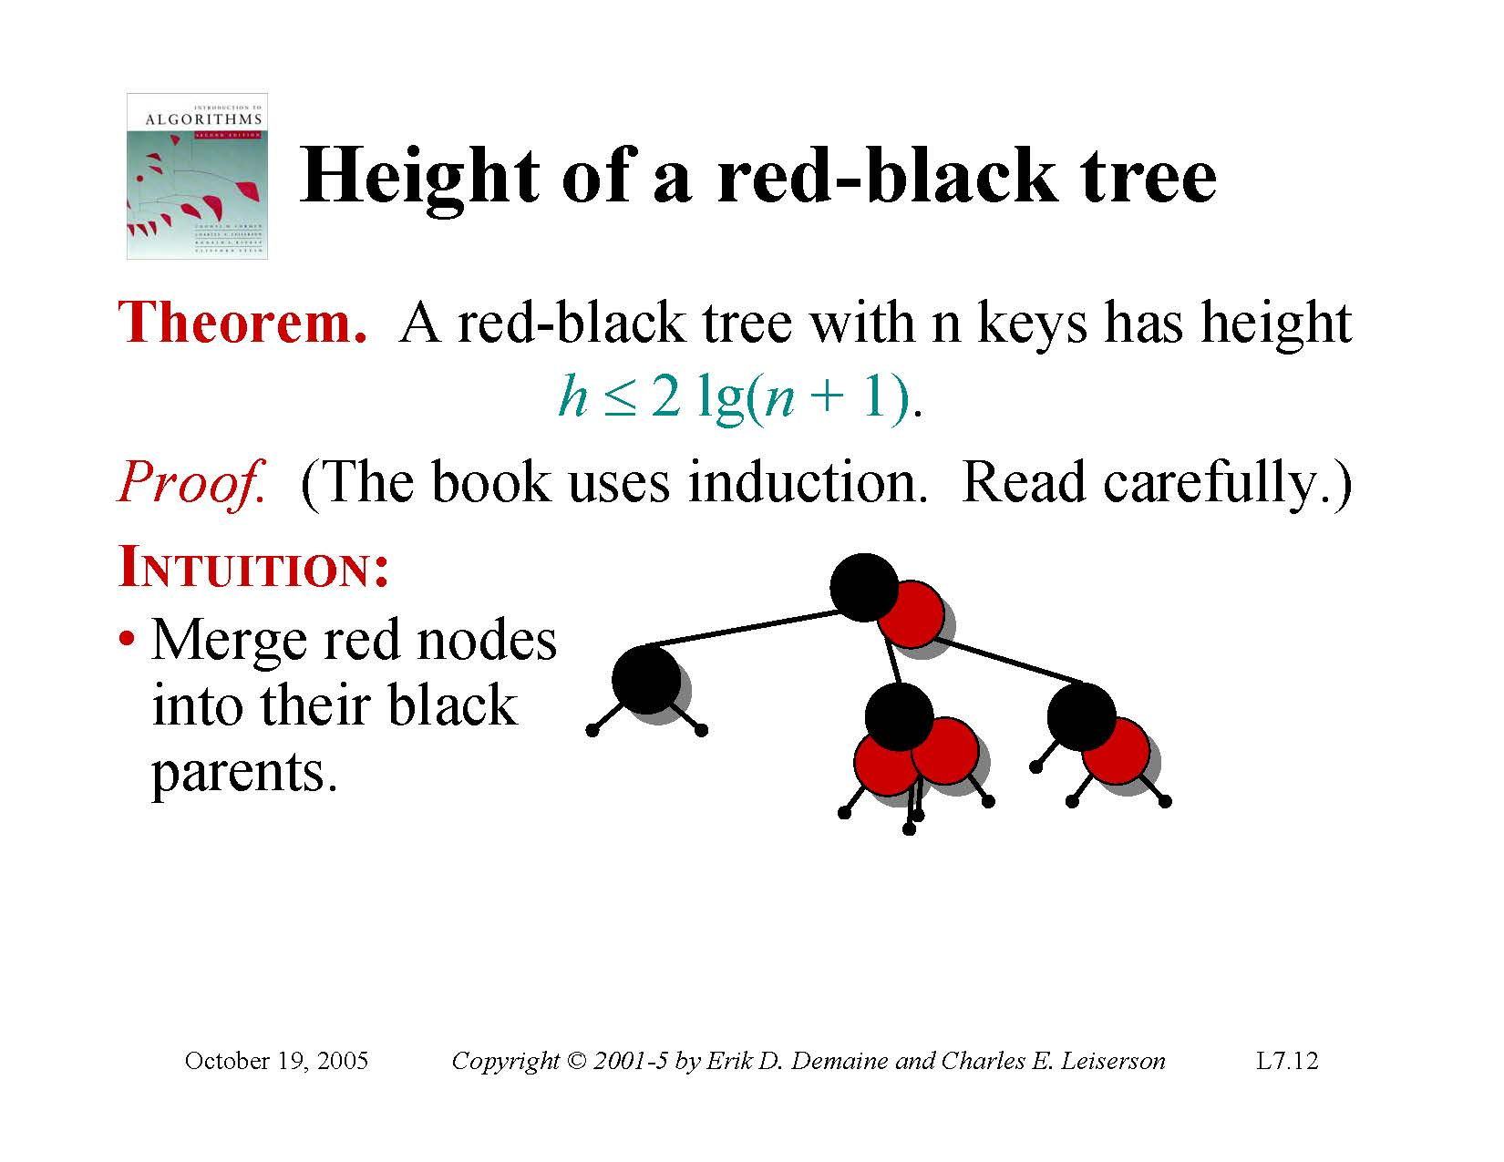

Slide 56
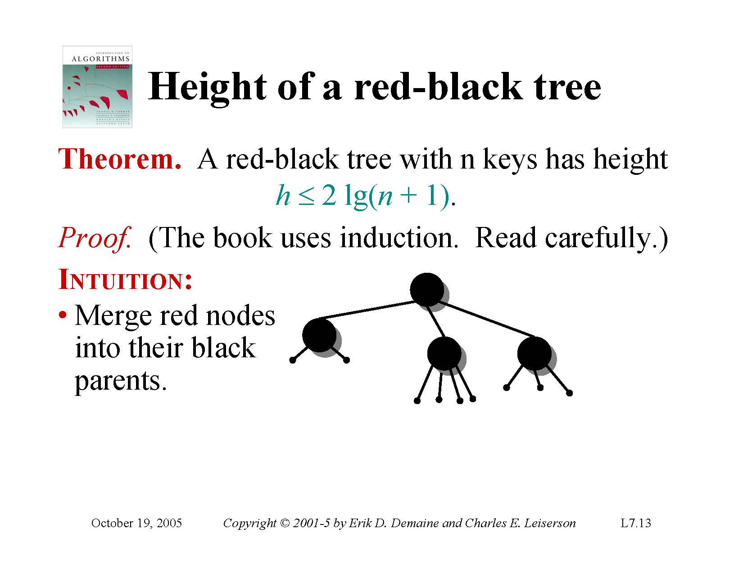

Slide 57
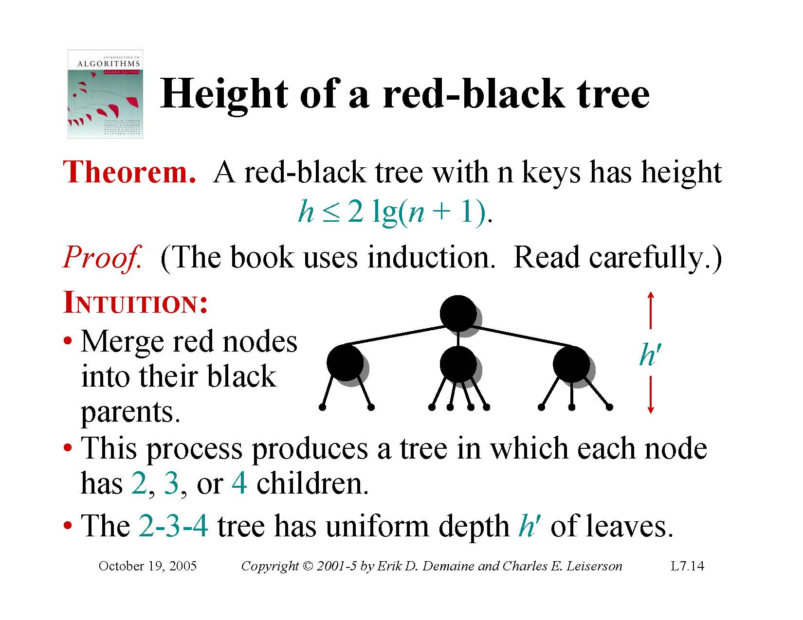

Slide 58
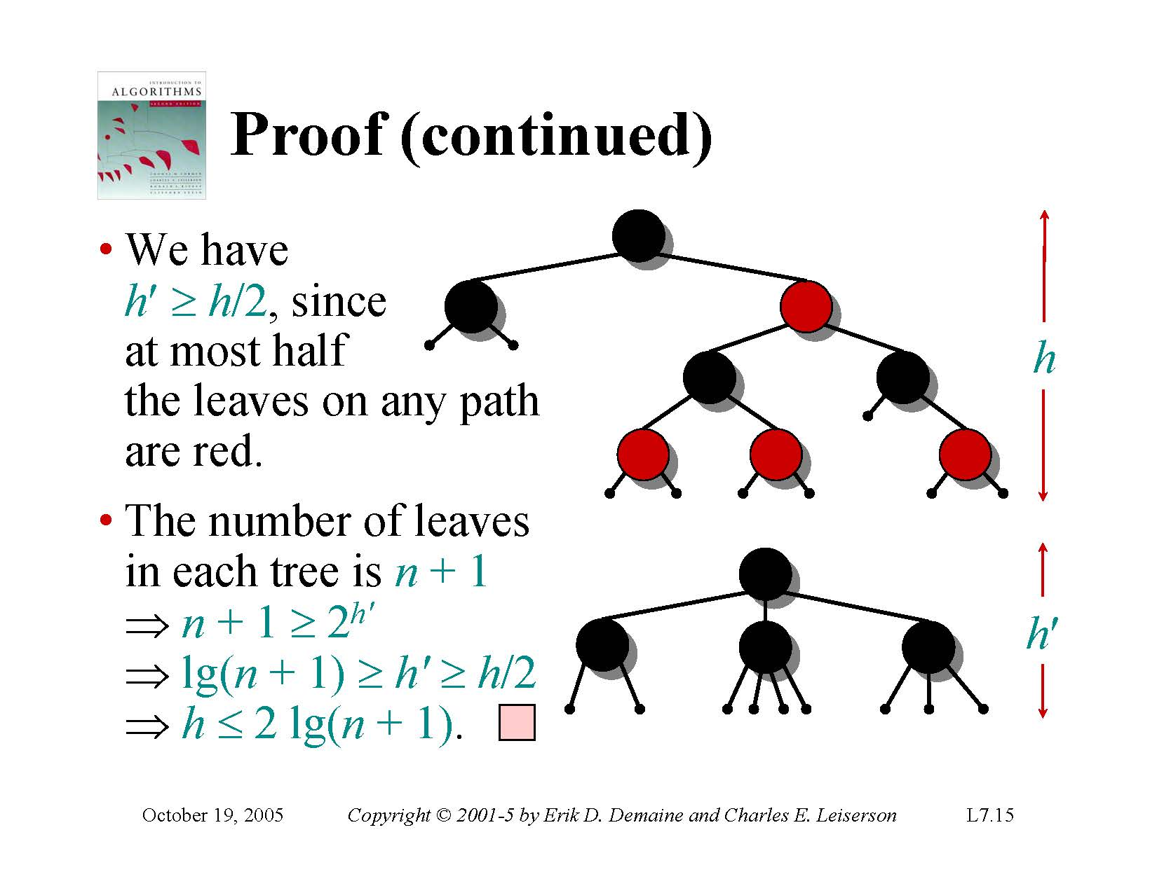
n: number of internal nodes
(except Nil)
minimum Nil nodes

Slide 59
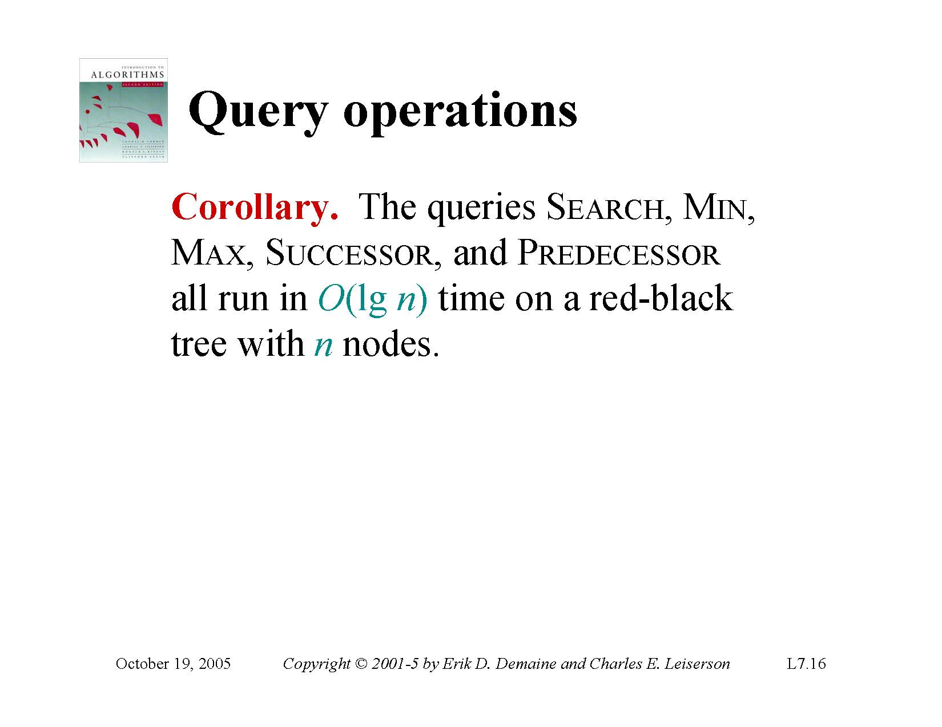
Notes:
알고리즘 A,B반 진도

Slide 60
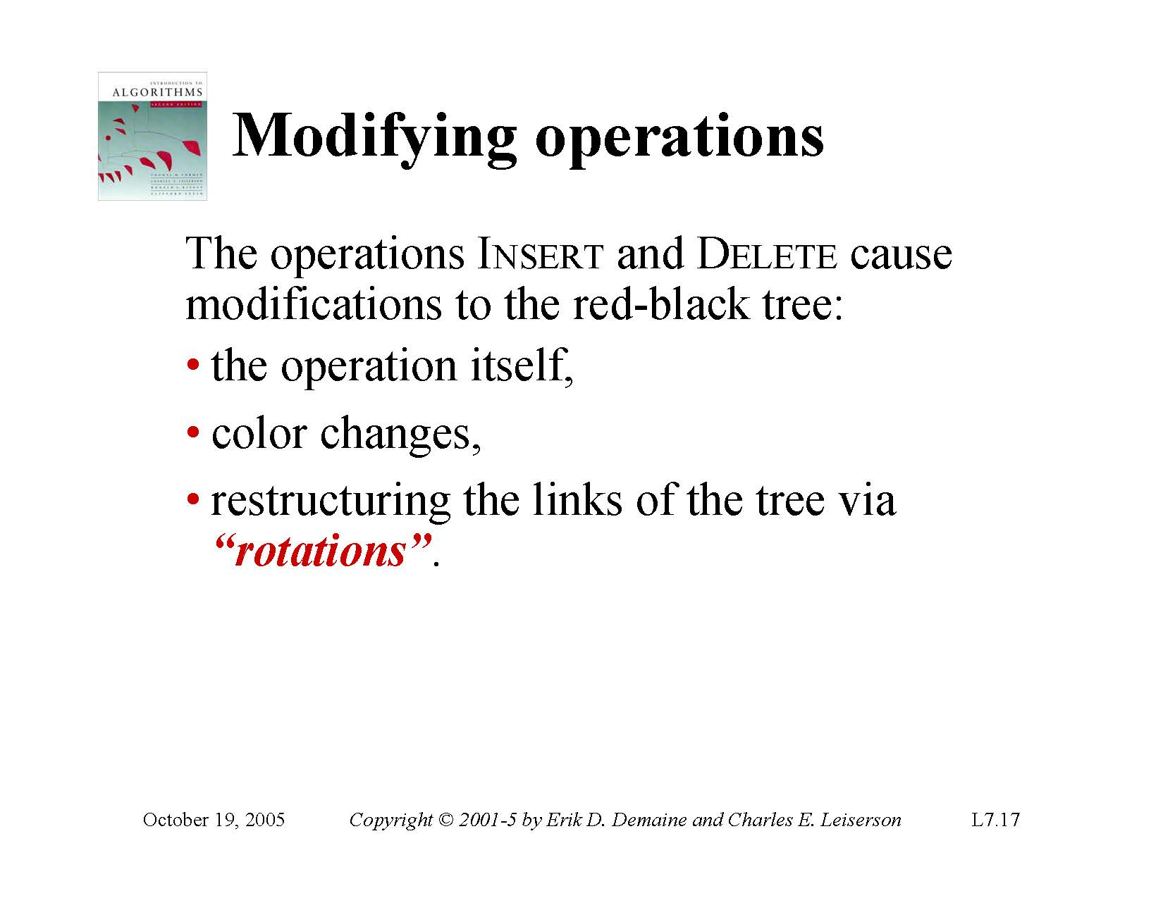

Slide 61
5 Cases After Insertion
Inserted node is root
Inserted node’s parent is black
Inserted node’s parent and uncle are red
Inserted node’s parent is red, uncle is black, and the node number is in between the parent and uncle number.
Inserted node’s parent is red, uncle is black, and the node number is not in between the parent and uncle number.
3,4, and 5 need structure modification

Slide 62
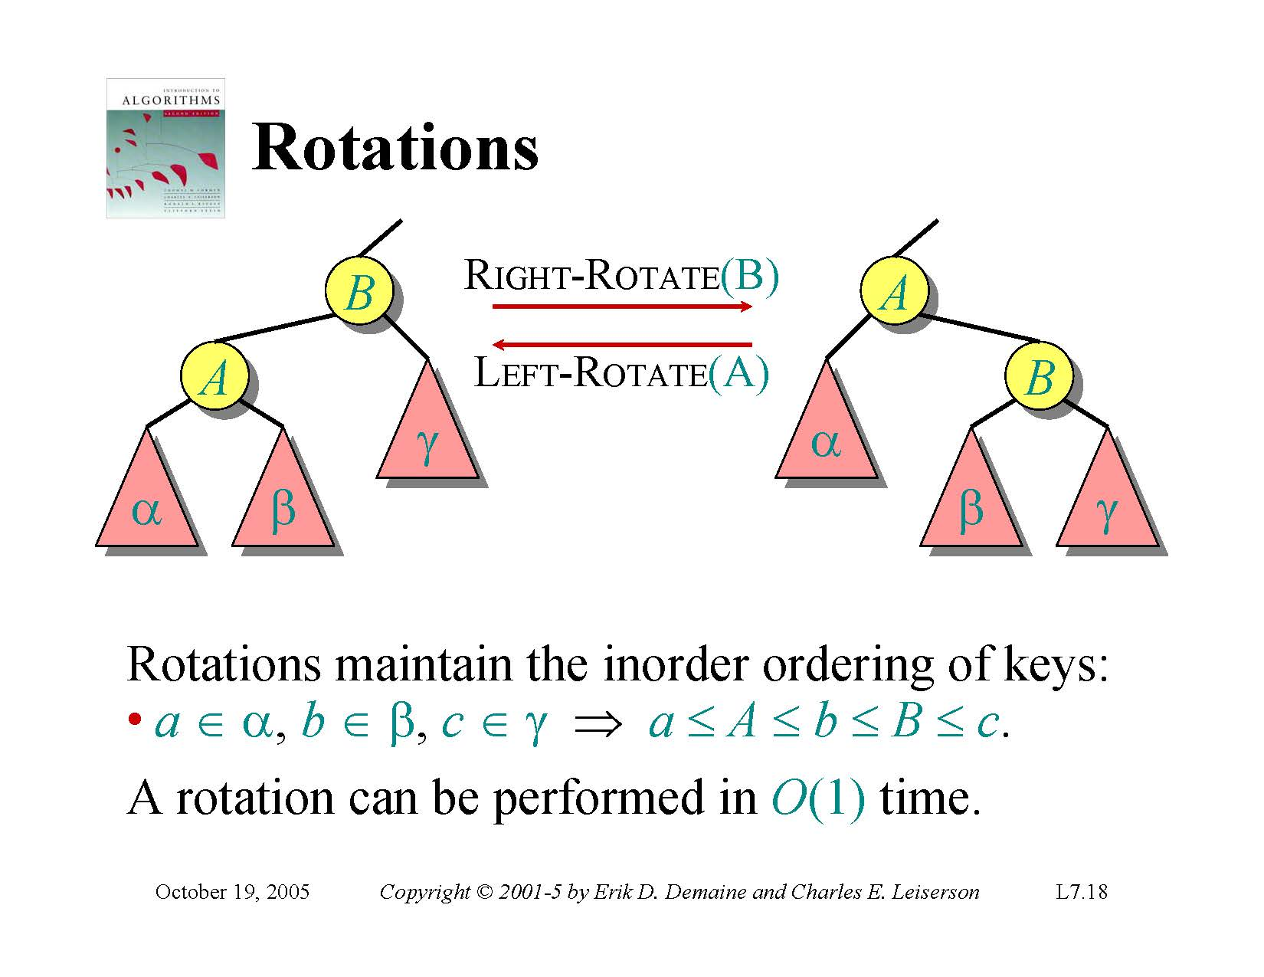

Slide 63
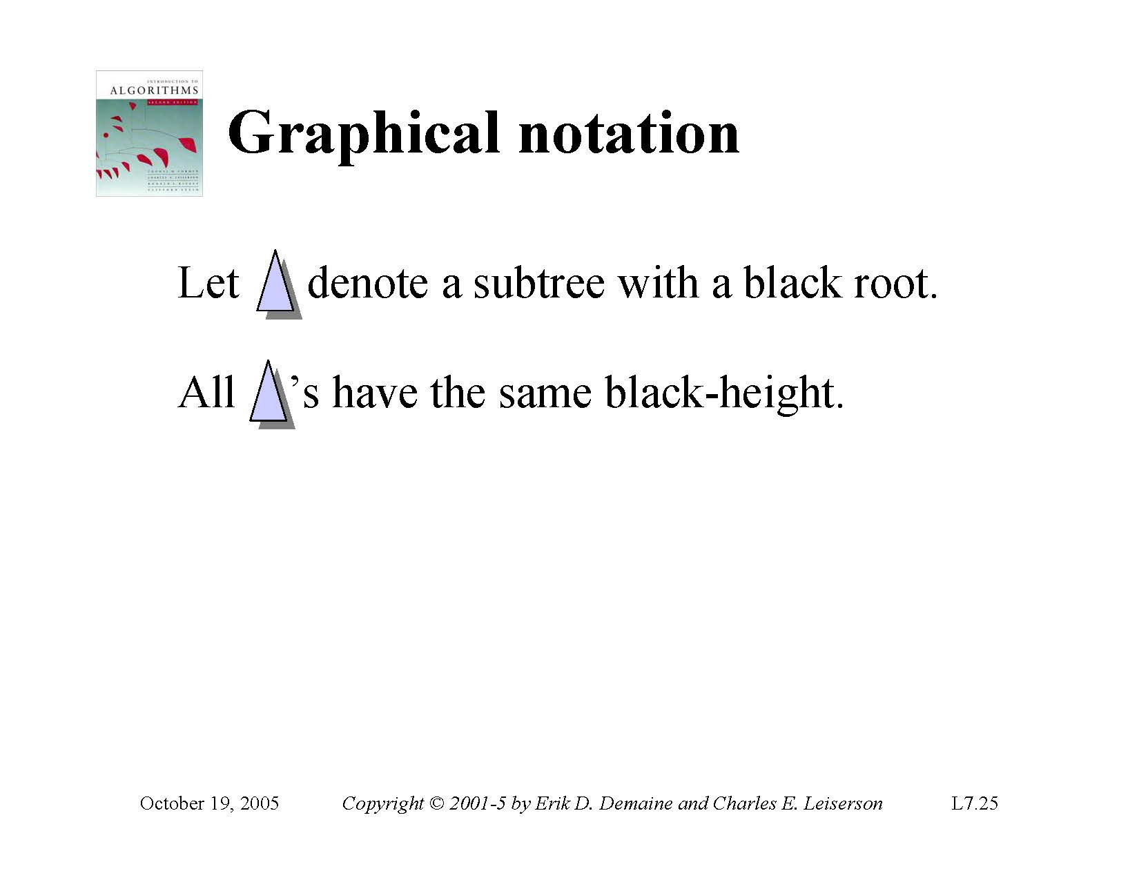

Slide 64
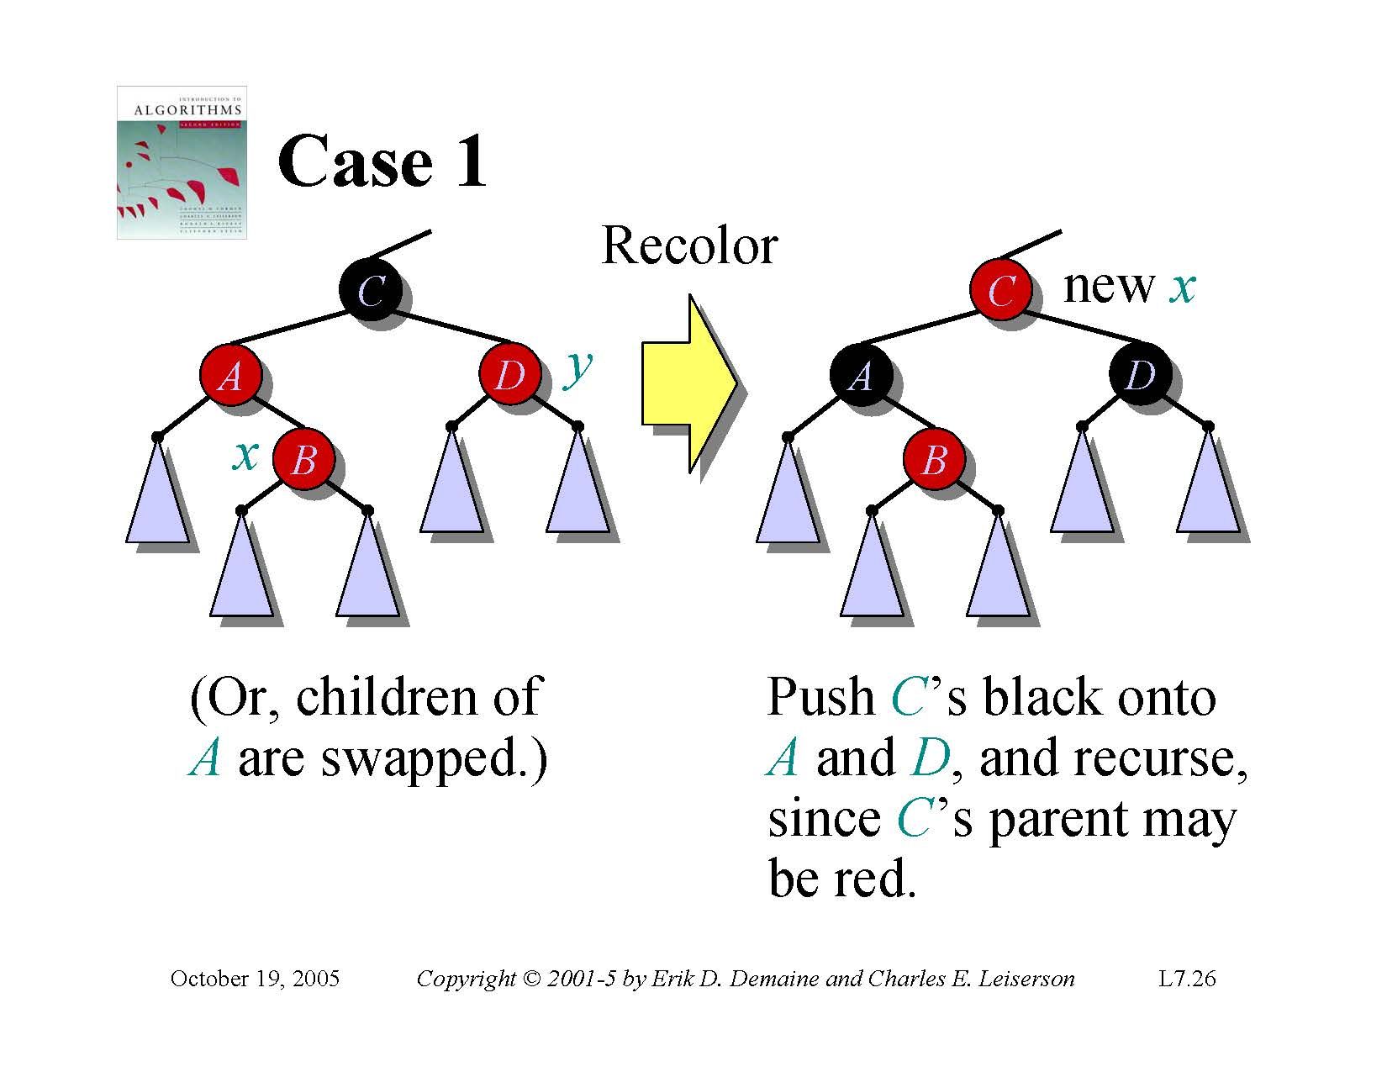

Slide 65
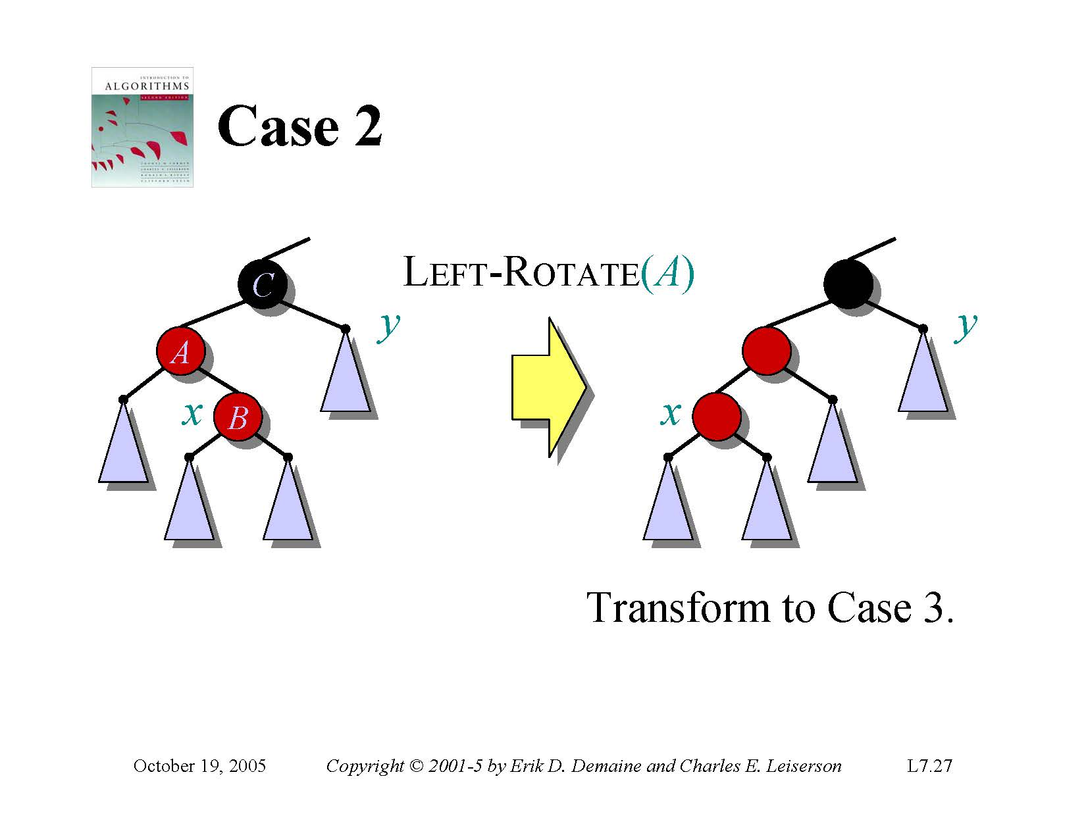

Slide 66
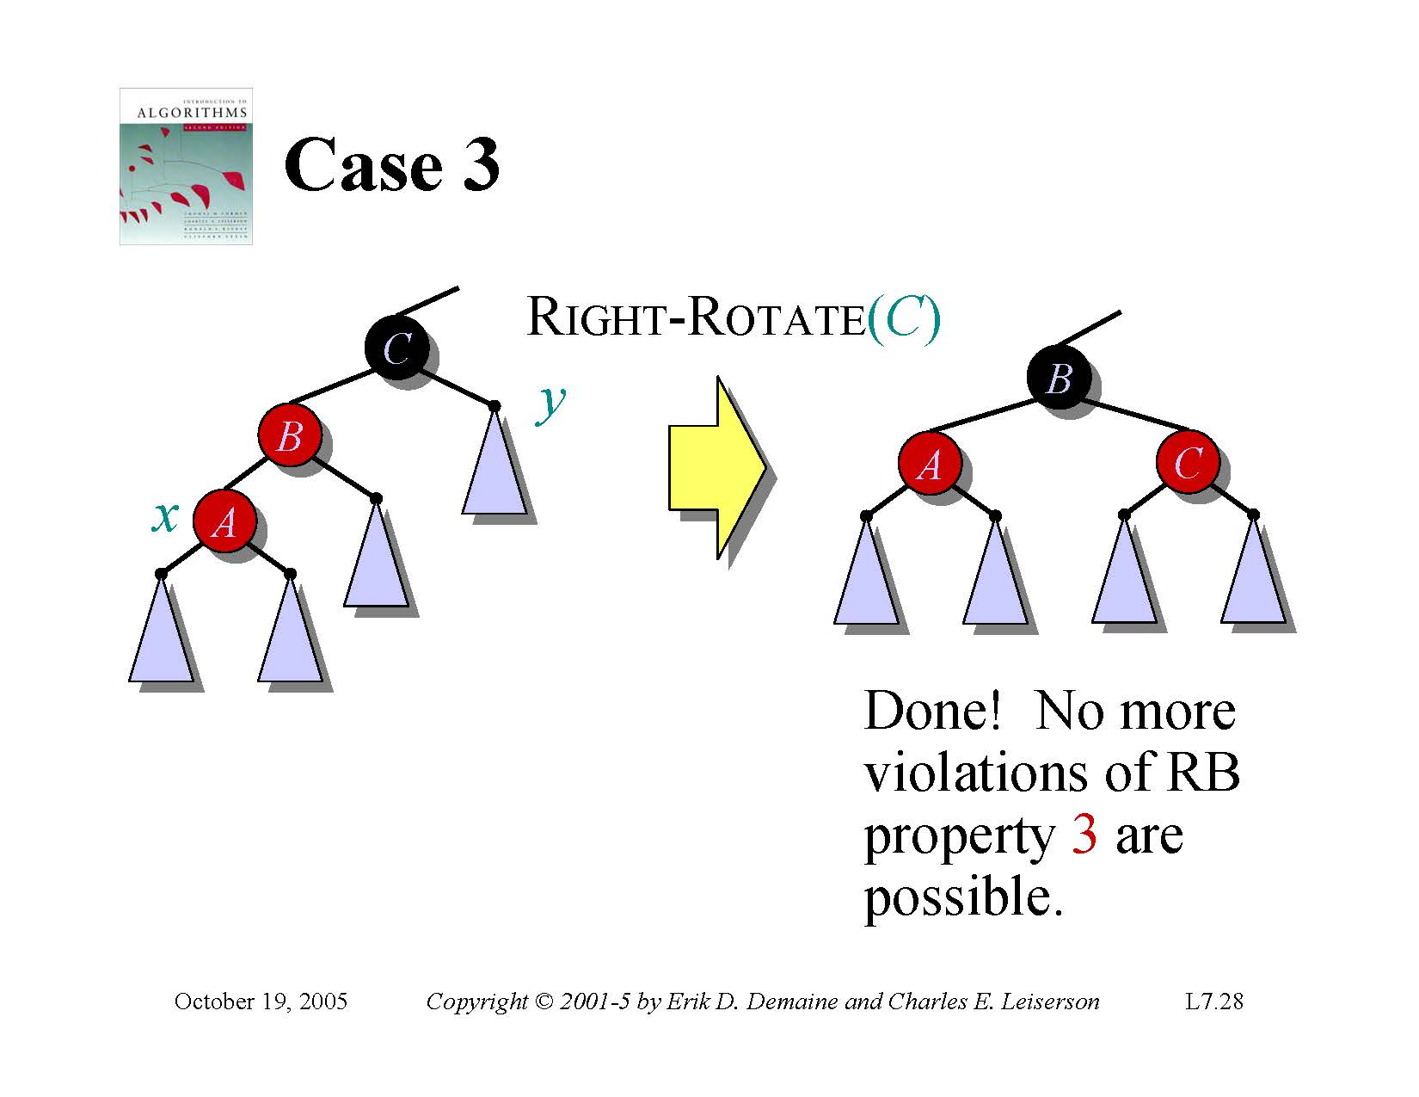

Slide 67
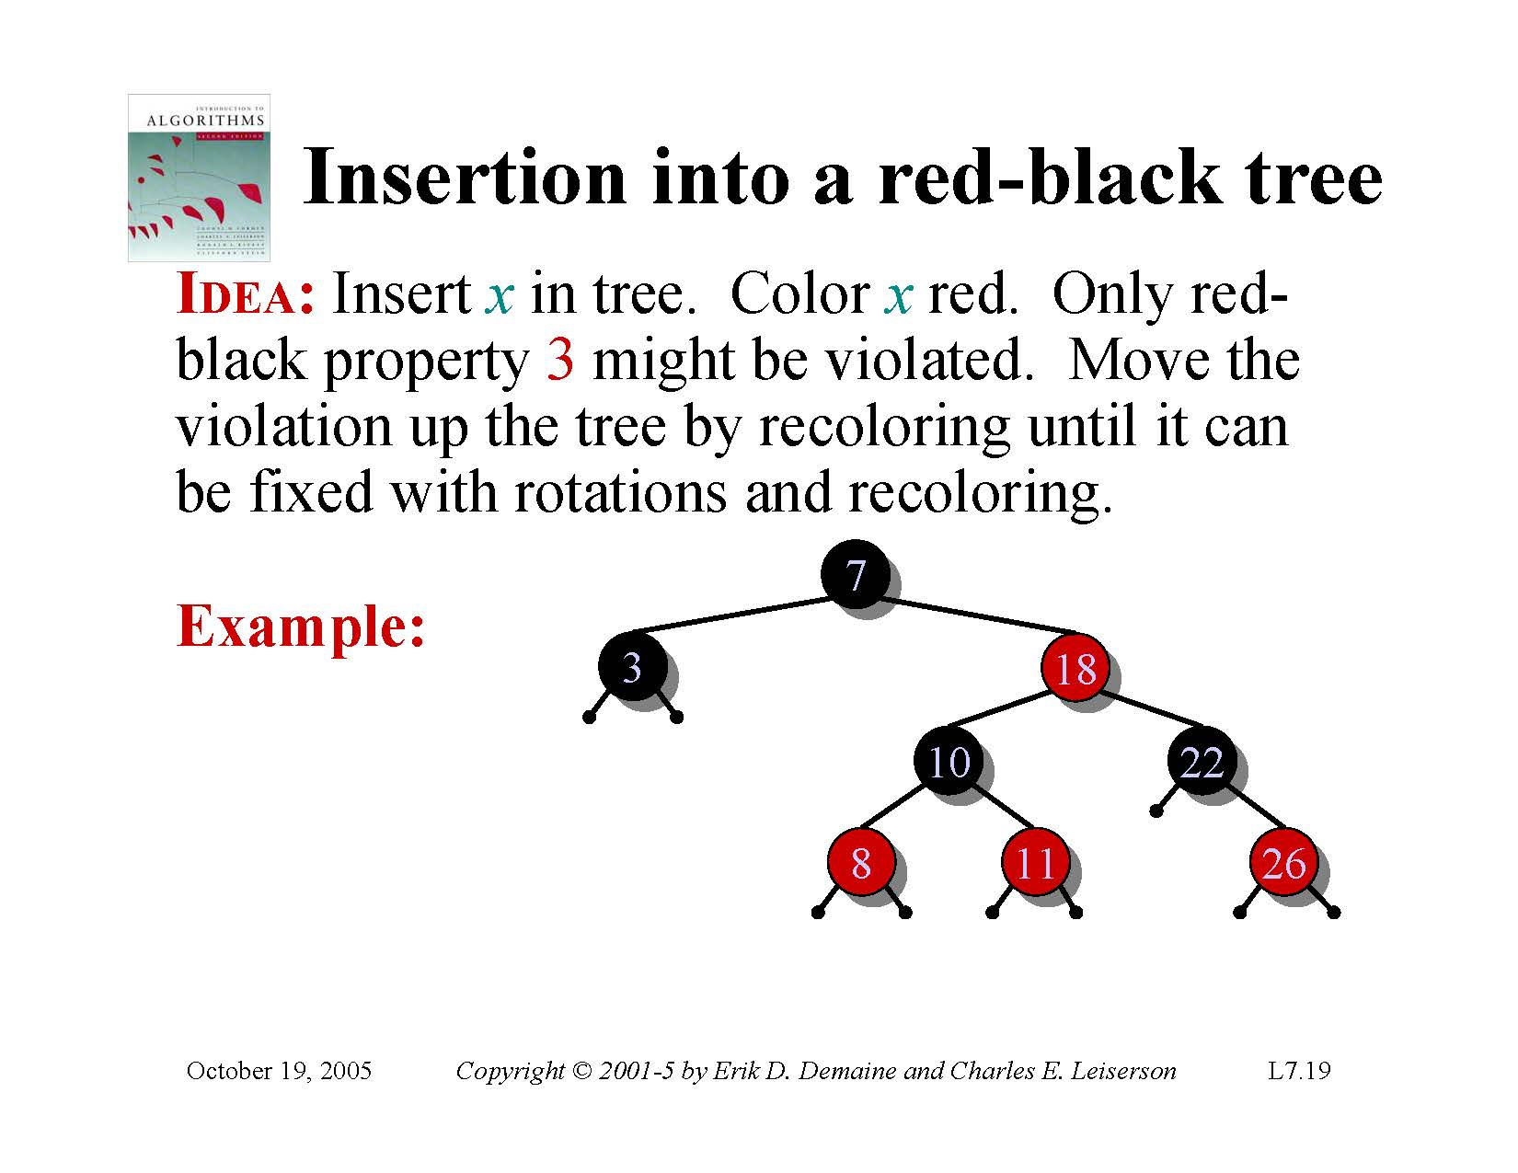

Slide 68
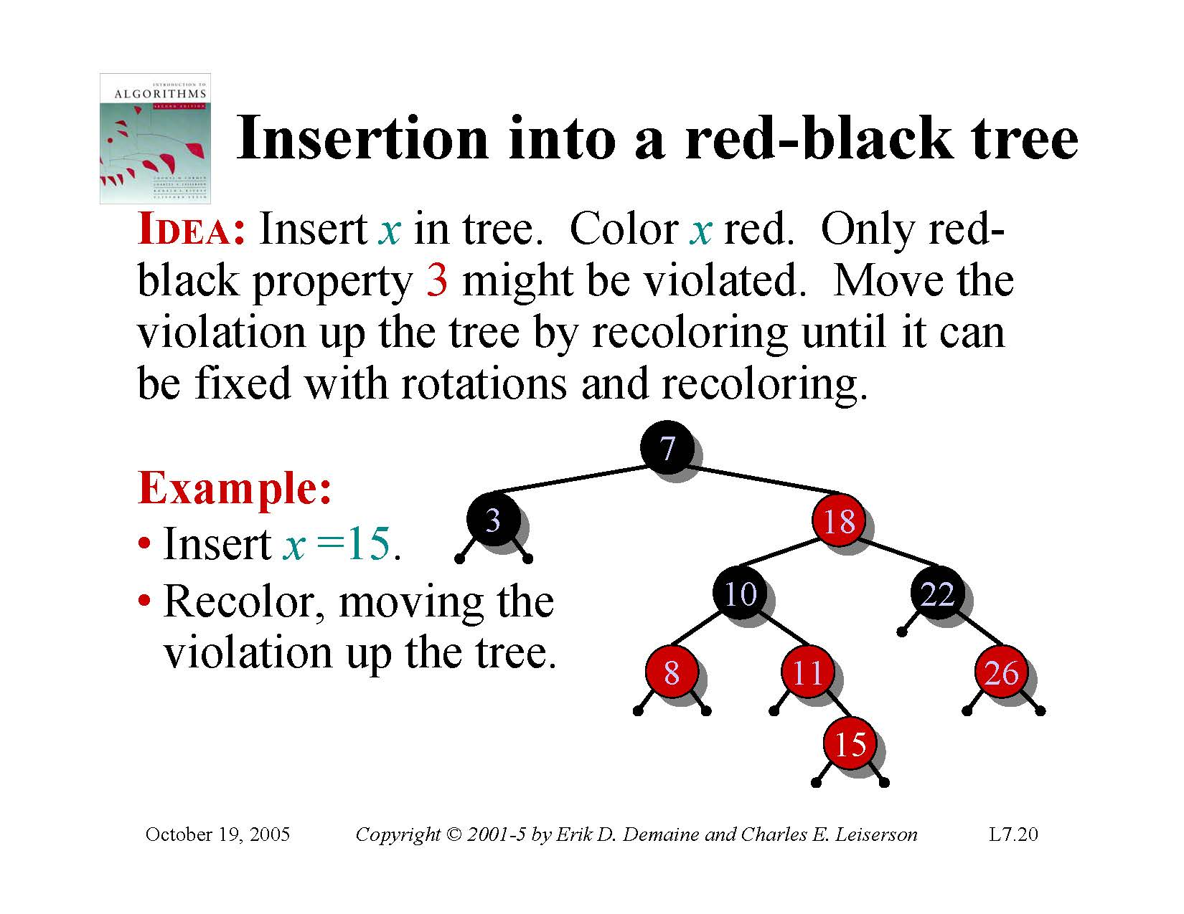

Slide 69
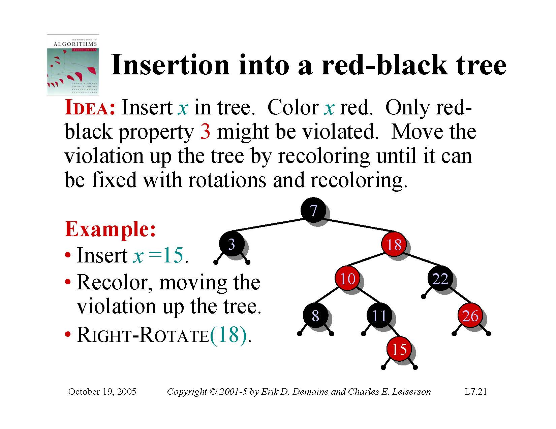

Slide 70
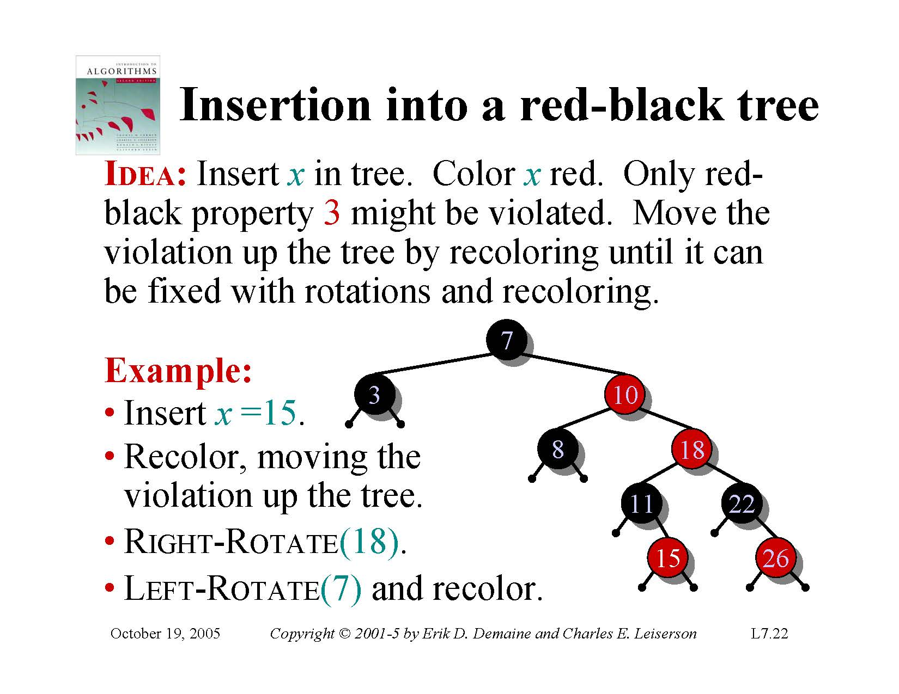

Slide 71
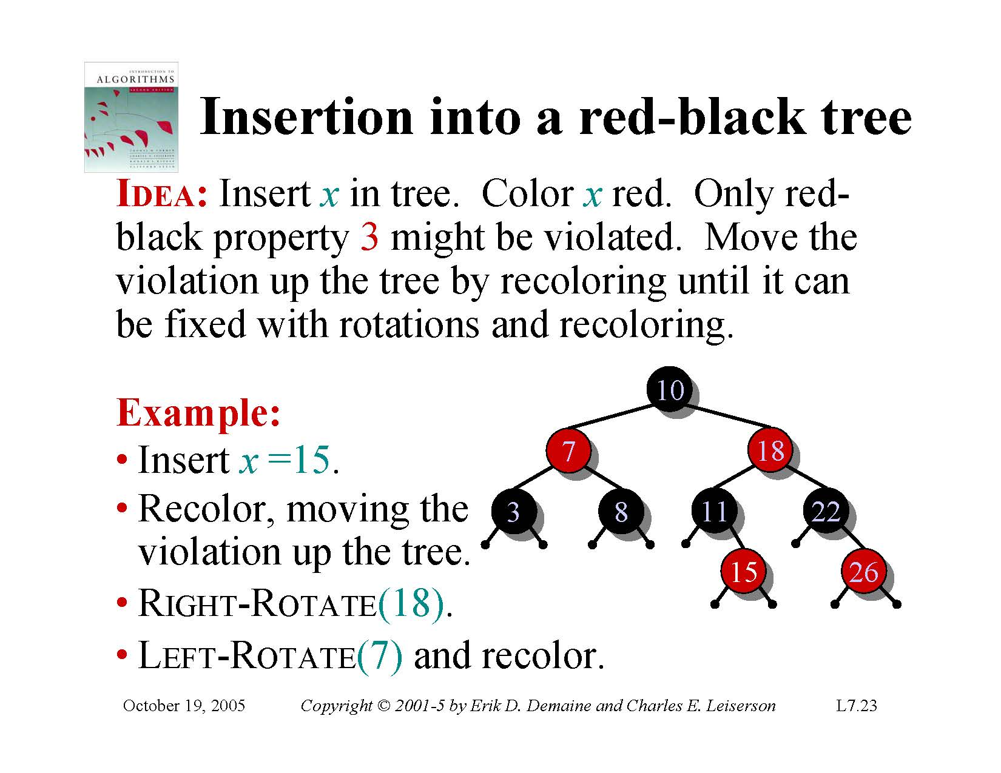

Slide 72
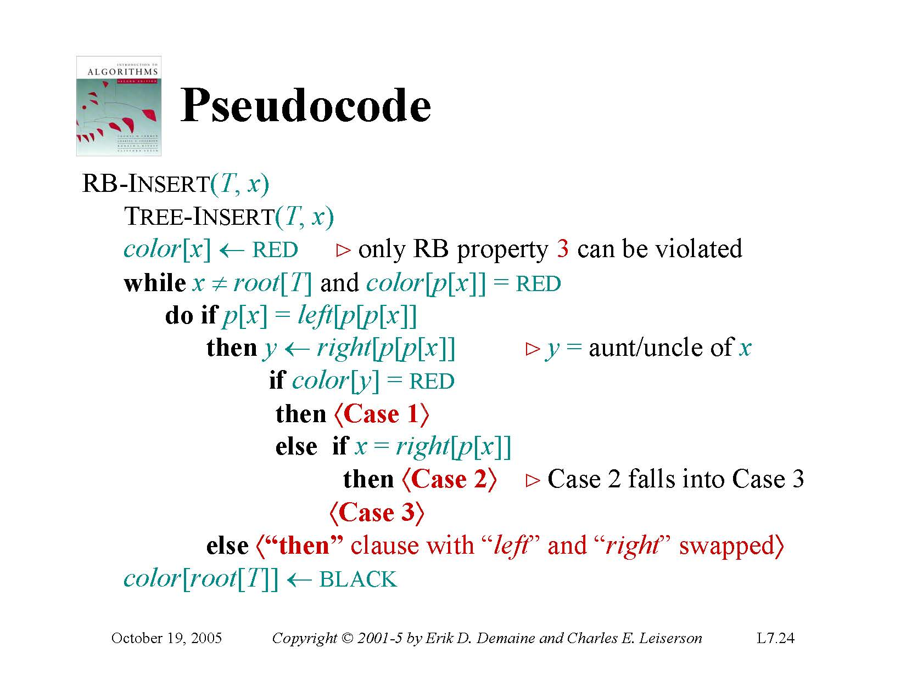

Slide 73
